Slide 1

Open Data and Web Services (ODWS)
mid-term homework
Group 3
Alice Laraspata, Claudio Morelli, Simon Danny Pettinella
2019/2020

Slide 2
Roadmap
What is the problem?
What is the need? And can open data meet this need?
Primary and Specific target
Expected results
Steps:
1. Ideation of the web service
2. Identification of the parameters
3. Data collection from the web
4. Cleaning and organization of the collected data

Slide 3



What is the problem?
The central problem is ENTREPRENEURIAL ECONOMIC UNCERTAINTY

Slide 4
What is the need?
Correct ORIENTATION of the market dynamics
Can open data meet this need?
YES, databases are capable of providing information and data relating to this need

Slide 5
Primary and Specific target
The PRIMARY TARGET is to ASSIST the stakeholder while operating an entrepreneurial choice
The SPECIFIC TARGET is to create a tool that can detect ATTRACTIVENESS and COMPETITIVENESS among European countries, analyzing and comparing general and sectoral economic data

Slide 6
Primary and Specific objective
European Country 1
1
General economic parameters
2
Analysis of economic sectors
Agriculture
Transport
Automotive
Sustainability
Technology
R&D

Slide 7
Expected results
How can the web service help the entrepreneur to orientate himself?
It will support the entrepreneur to make the best choice of SECTOR in the European country where he intends to INVEST
Furthermore, the entrepreneur will be able to examine the DEVELOPMENT of a specific index in five years time within the same country

Slide 8
Activities facies
1. Ideation of the web services: What is the idea?
The web service will have to be able to POSITION the various European countries in a RANKING according to the general economic parameters; it will then have to be able to DEEPEN the competitiveness level in each specific market
The key performance of the entire web service is to be able to COMPARE European countries according to markets or market parameters, creating a ranking for EVERY NEED

Slide 9
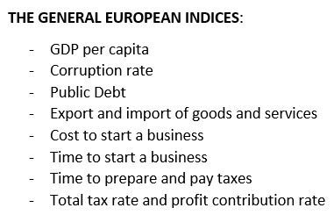
Activities facies
2. Identification of the parameters
FIRST STEP: to IDENTIFY the parameters that could provide the general economic picture of each European country.
In this regard, the GENERAL EUROPEAN INDICES as follows:

Slide 10
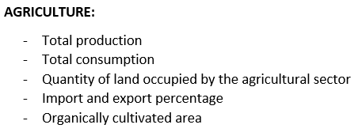
Activities facies
2. Identification of the parameters
SECOND STEP: to ANALISE the following SIX MACRO-SECTORS of each European countries, choosen on the bases of the highest levels of Italian turnover in recent years, with the rispective indices:
1

Slide 11
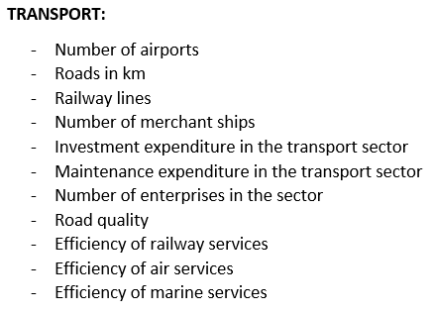
Activities facies
2. Identification of the parameters
2

Slide 12
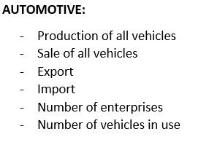
Activities facies
2. Identification of the parameters
3

Slide 13
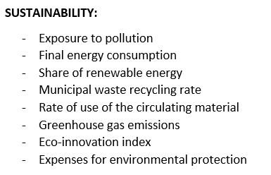
Activities facies
2. Identification of the parameters
4

Slide 14
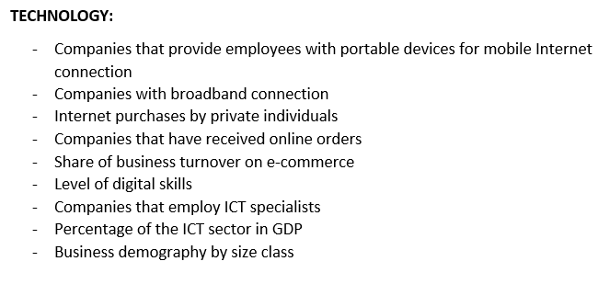
Activities facies
2. Identification of the parameters
5

Slide 15
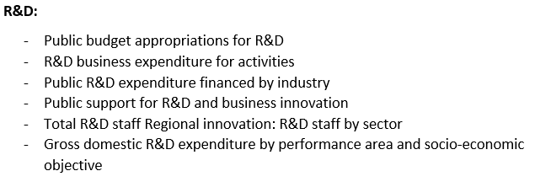
Activities facies
2. Identification of the parameters
6

Slide 16

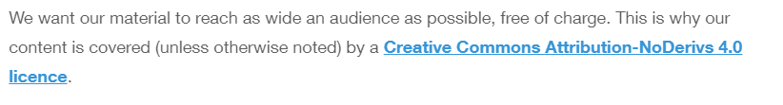
Activities facies
3. Data collection from the web
The databases used are:
1
https://www.transparency.org/permissions

Slide 17
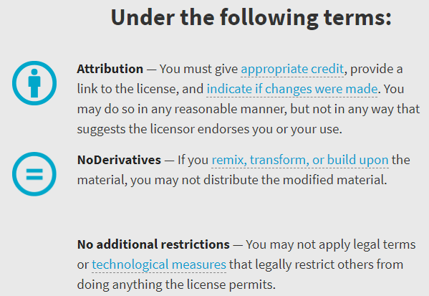
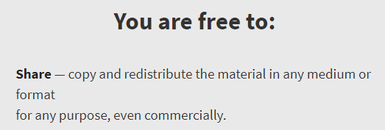
Activities facies
Creative Commons Attribution-NoDerivs 4.0 licence (CC BY-ND 4.0)
https://creativecommons.org/licenses/by-nd/4.0/

Slide 18

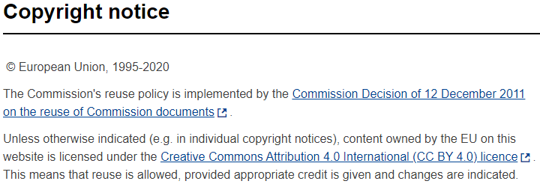
Activities facies
3. Data collection from the web
2
https://ec.europa.eu/info/legal-notice_en

Slide 19
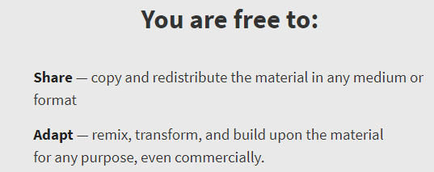
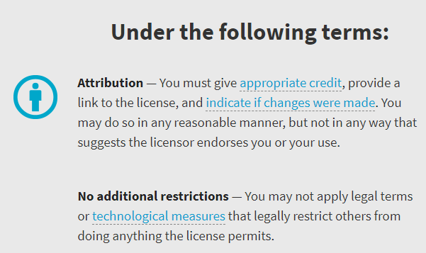
Activities facies
Creative Commons Attribution 4.0 International licence (CC BY 4.0)
https://creativecommons.org/licenses/by/4.0/

Slide 20

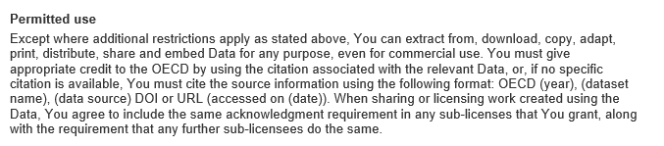
Activities facies
3. Data collection from the web
3
http://www.oecd.org/termsandconditions/

Slide 21

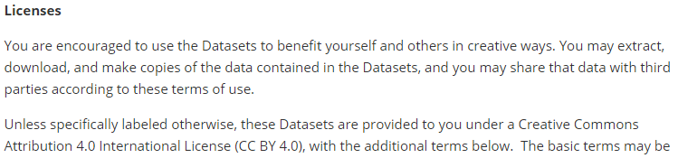
Activities facies
3. Data collection from the web
4
https://www.worldbank.org/en/about/legal/terms-of-use-for-datasets

Slide 22
Activities facies
Creative Commons Attribution 4.0 International licence (CC BY 4.0)
https://creativecommons.org/licenses/by/4.0/

Slide 23

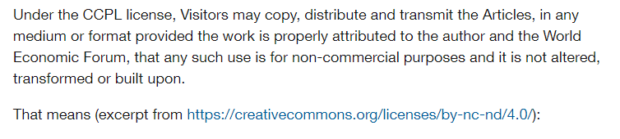
Activities facies
3. Data collection from the web
5
https://www.weforum.org/about/terms-of-use

Slide 24
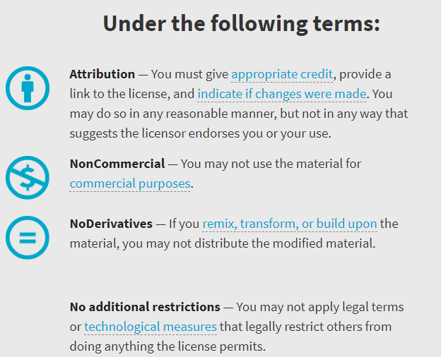
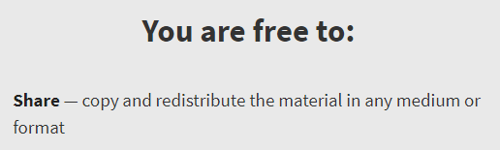
Activities facies
Creative Commons Attribution-NonCommercial-NoDerivatives 4.0 International licence (CC BY-NC-ND 4.0)
https://creativecommons.org/licenses/by-nc-nd/4.0/

Slide 25
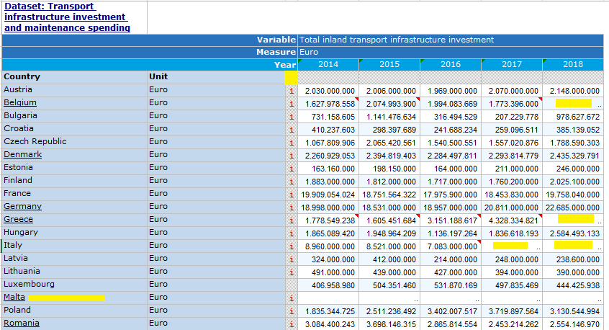
Activities facies
3. Cleaning and organization of the collected data
OECD dataset

Slide 26
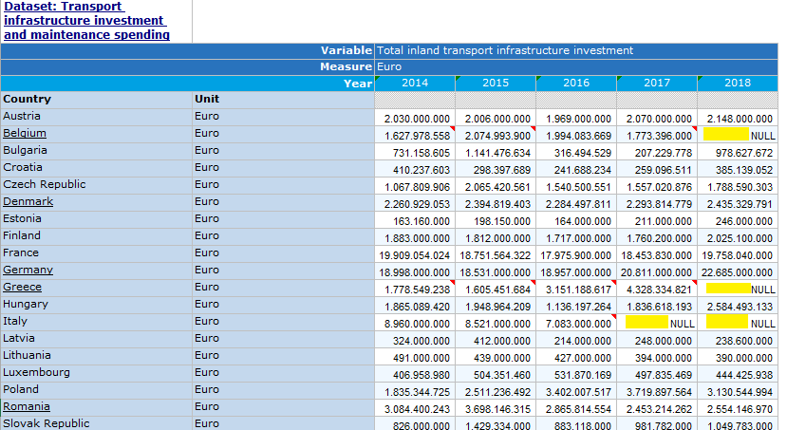
Activities facies
3. Cleaning and organization of the collected data
The cleaned OECD dataset

Slide 27
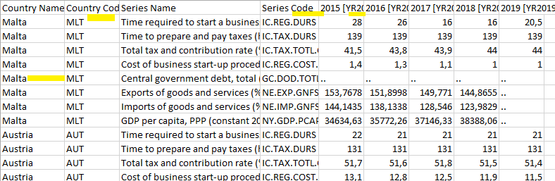
Activities facies
3. Cleaning and organization of the collected data
The THE WORLD BANK dataset

Slide 28
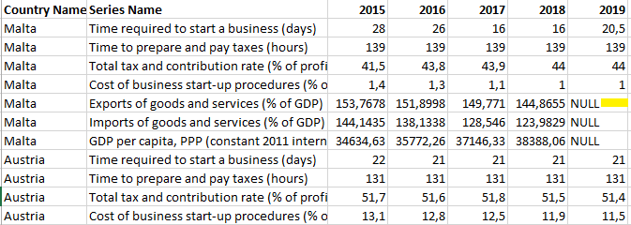
Activities facies
3. Cleaning and organization of the collected data
The cleaned THE WORLD BANK dataset

Slide 29
Activities facies
3. Cleaning and organization of the collected data
Data concern exclusively the twenty-seven European countries
Data refer to the five last available years starting from year 2019 as the most recent year
The European countries having no data for a specific index, for the entire period, have not been considered for that index only; In case of no data for some of the five years, the missing data will be considered as NULL
A file excel for each index has been created

Slide 30
Thanks for your attention
Alice Laraspata, Claudio Morelli, Simon Danny Pettinella
2019/2020

